Slide 1


WNBA Data Analysis using Cloud-based Tools
A comprehensive journey from raw data to insightful analytics
Elvina Sutislio, Peiling Zou, Yayuan Zhang, Yee Nuan Chan
ISM 6362: Big Data and Cloud-Based Tools
Prof. Anthony Kwiatkowski
Notes:
Good day everyone! I'm excited to present our project today: A deep dive analysis of WNBA data using advanced cloud-based tools, as part of our "Big data and cloud based tools" course.

Slide 2
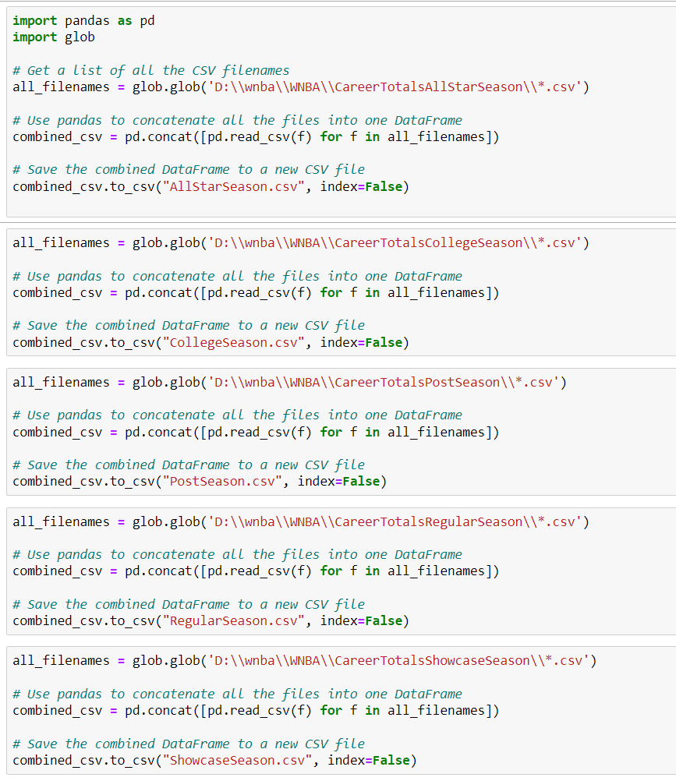

Analyzing WNBA player metrics
The original dataset: 4747 rows 27 columns
Season Totals Regular Season folder
Dataset: 1076 CSV file
One Excel Spreadsheet
Player ID
Season ID
League ID
Team ID
Team Abbreviation
Player Age
Filed goals made
Games Played
Games Started
Played Minutes
Total Points
Data Ingestion and Storage
Data Preprocessing
Batch & Event Processing
Machine Learning & Analytics
Achievements & Hurdles
Notes:
Our journey began with a multitude of data: 1076 csv files, provided by our professor, all containing diverse and valuable WNBA player metrics. Rather than analyzing disjointed datasets, we chose to amalgamate these files into one cohesive Excel spreadsheet, setting the stage for a more structured and effective analysis.
In here, we used python spark programming language to combine these datasets as one, the original dataset

Slide 3
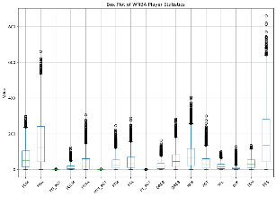
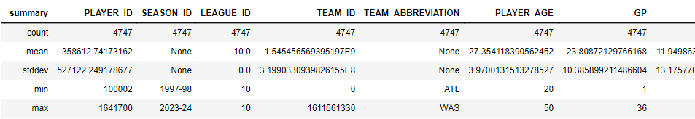
Import Essential Libraries
Data Type Changes
Handle Outliers
Handle Zero Values
Data Cleaning Summary
pyspark.context
pyspark.sql
pyspark.sql.functions
pyspark.sql.types
Pandas
matplotlib
Converting PLAYER_AGE from double to integer for more accurate representations
Df.dtypes
Data Modifications
Detecting, analyzing and addressing outliers in several columns
IQR
Box Plot
Zero Values Analysis
Team ID has 4.11% zero values
After the cleanup, the dataset now consists of 4551 rows and 27 columns
Data Pre-processing – Python Spark
Data Integrity Check
Descriptive Statistics
Data Consistency
Unique Values Inspection
Missing Values Assessment
Detecting, analyzing and addressing outliers in several columns like PLAYER_AGE, FGM, FGA, and more.
summary = df.describe()
summary.toPandas()
Data Validation
Team Abbreviation
df.filter(~col("TEAM_ABBREVIATION").isin(valid_abbreviations))
df.filter(~col("TEAM_ABBREVIATION").rlike("^[A-Z]+$"))
df.filter(length(col("TEAM_ABBREVIATION")) != 3)
No missing values
df.select([count(when(col(c).isNull() | isnan(c), c)).alias(c) for c in df.columns])

Slide 4
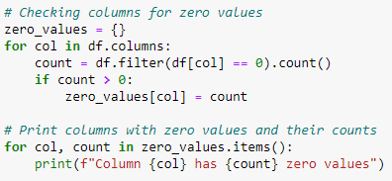
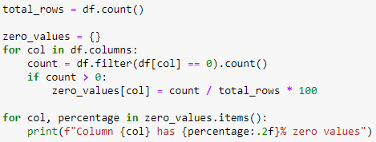
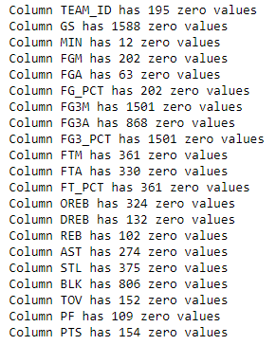
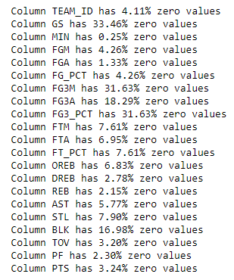
Data Preprocessing
Zero Values Analysis
TEAM_ID: 4.11% zero values. Potential missing or unknown teams
GS: 33.47% zero values. Some players might not start games
MIN: 0.25% zero values. Indicates minimal playtime for certain players
Shooting Metrics (FGM, FGA, FG3M, etc.): Varies between 1% to 32%. Indicates varied player contribution.
Player Actions (AST, STL, REB, etc.): Between 2% to 18%. Reflects different player roles
Data Validation
High zero-values for certain metrics can be expected due to varying player
TEAM_ID zero values might indicate missing data and need remove

Slide 5
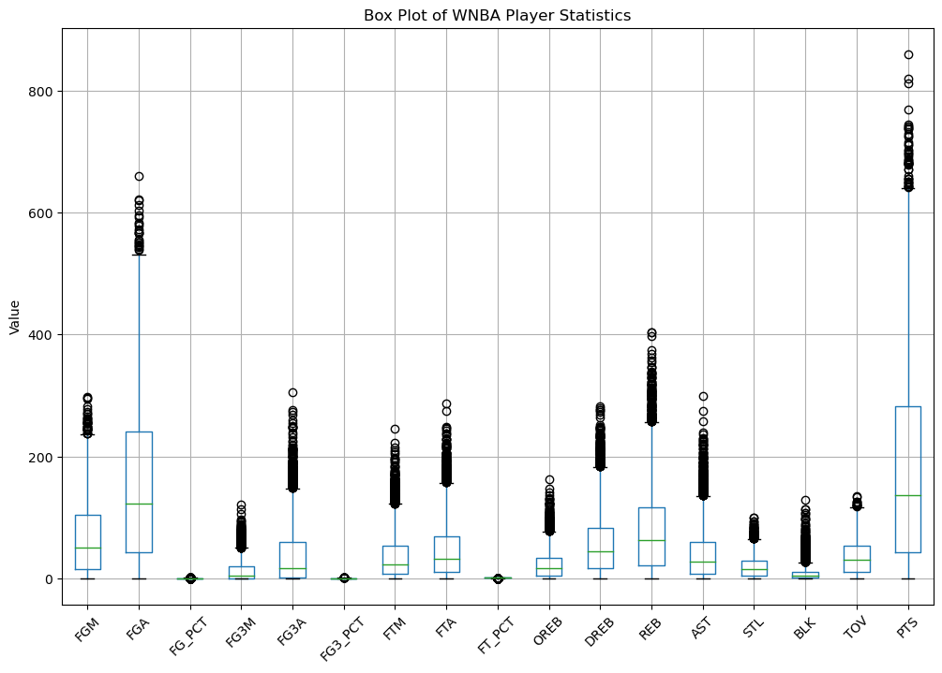
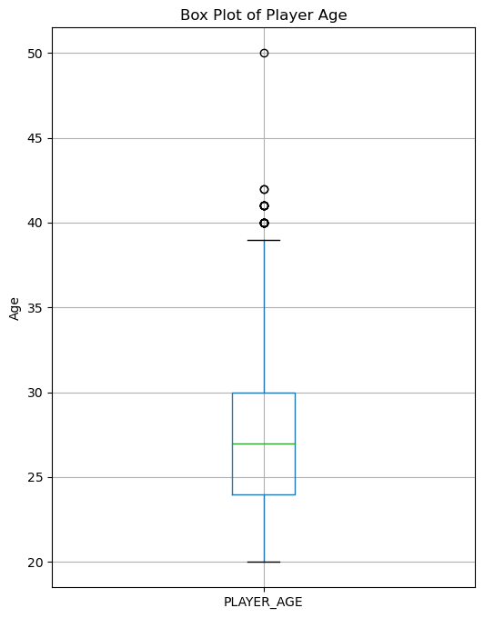
Data Preprocessing
Outliers
IQR
Box Plot
Age of 50 is extremely rare
By 50, most players have retired
Physical & competitive constraints
Data Validation
All values within the expected range
No outliers identified
No further outlier handling required
Remove data point of 50

Slide 6

Save to Azure Blob Storage
wasbs://mycontainer@myaccount.blob.core.windows.net/
Databricks
4551 rows 27 columns
Connection
Storage
Container
Define a mount point within Databricks
Access point
Secret Keys
Secure authentication
Save as a CSV file
df.write.csv("/mnt/cleaneddata1/cleanedata.csv")

Slide 7
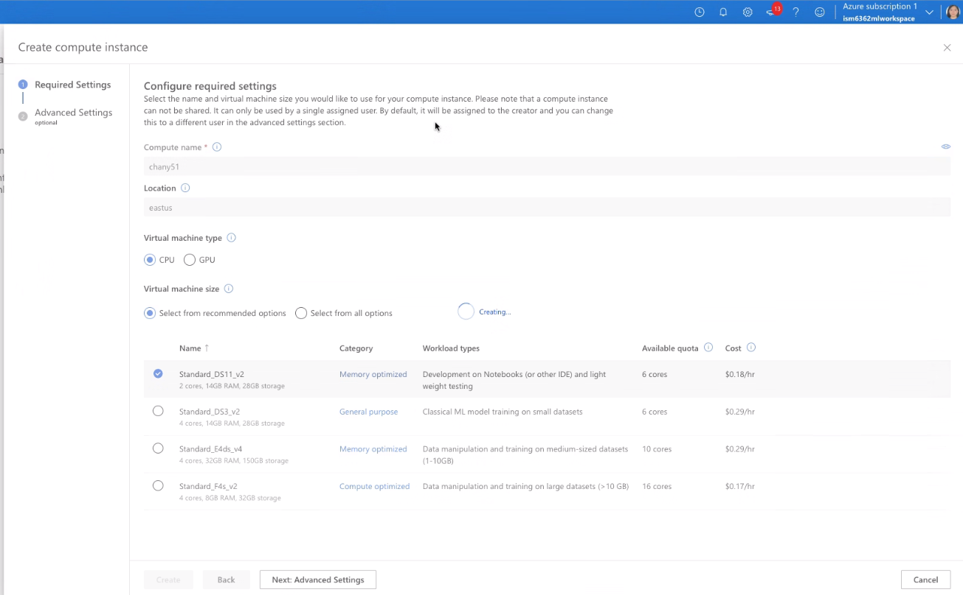
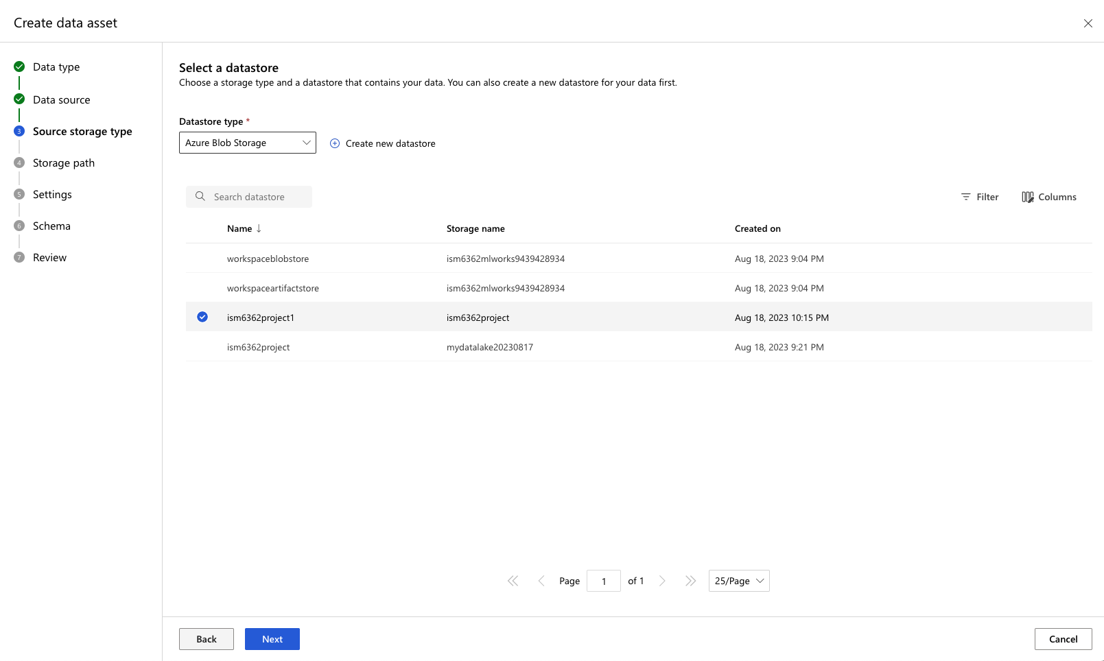
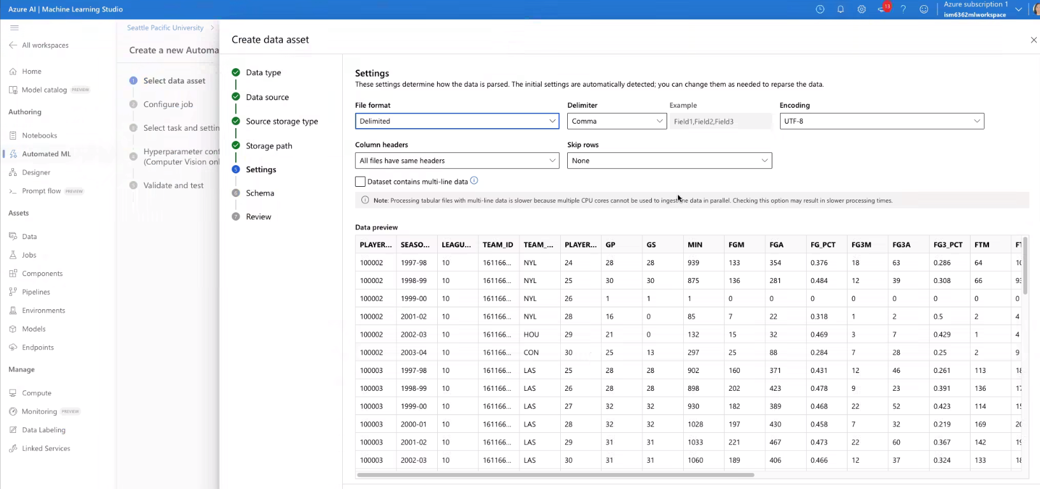
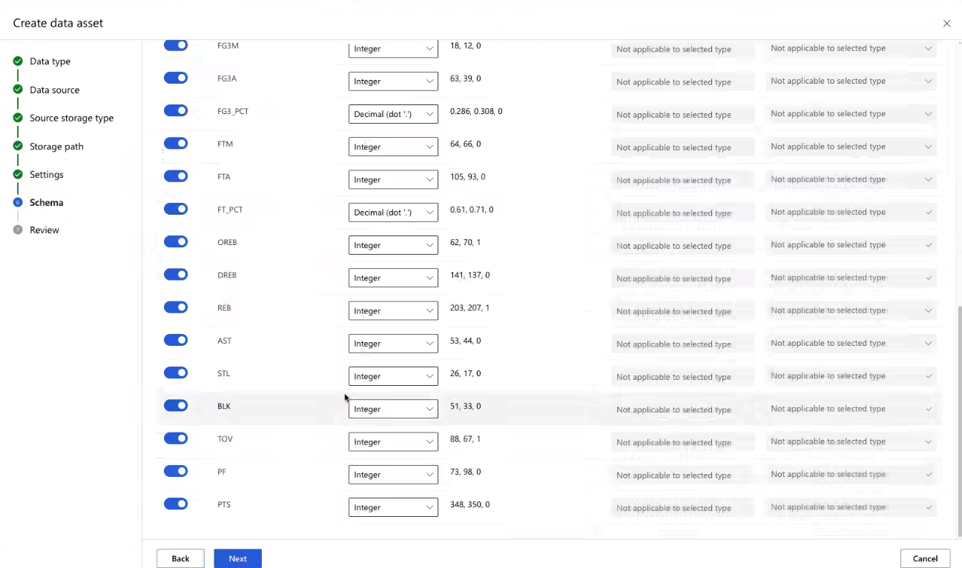
Batch & Event Processing
Data Ingestion and Storage
Data Preprocessing
Batch & Event Processing
Machine Learning & Analytics
Achievements & Hurdles
Notes:
Utilizing cloud computing platforms, we managed smooth batch processing, ensuring data effortlessly transitioned into our analysis tools. Simultaneously, event handlers were set up, priming our system for automated and appropriate actions upon new WNBA data imports.

Slide 8
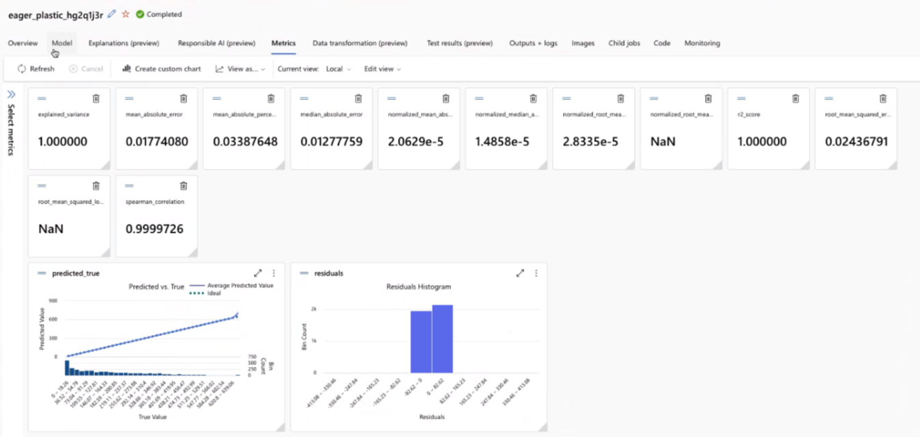
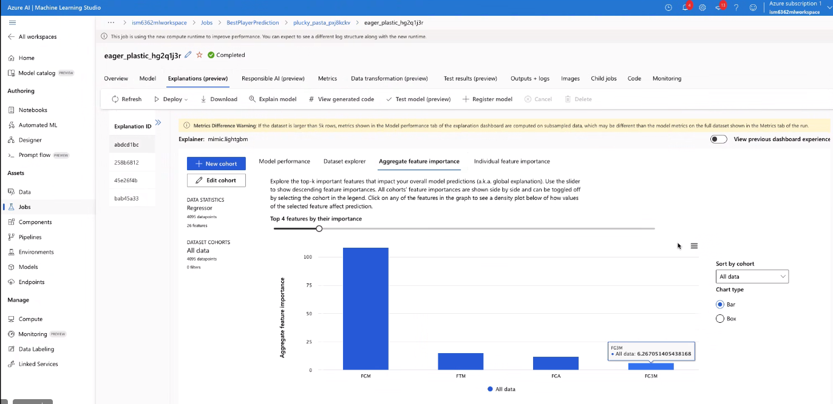
Machine Learning and Analytics Application
Data Ingestion and Storage
Data Preprocessing
Batch & Event Processing
Machine Learning & Analytics
Achievements & Hurdles
Notes:
Lastly, we harnessed machine learning to deep dive into player performance ...........

Slide 9
Went Well
Did not go well
Future Directions
Streamlined Analysis
Data Preprocessing
Outliers Management proved tricky
Cloud tool integrations demanded a steep learning curve
Azure operations
Costly
automate more preprocessing steps
Integrating real-time data processing for near-instant analytics is another direction.
References
https://www.kaggle.com/datasets/pavansubhasht/ibm-hr-analytics-attrition-dataset
Data Ingestion and Storage
Data Preprocessing
Batch & Event Processing
Machine Learning & Analytics
Achievements & Hurdles
Notes:
Our journey was characterized by both triumphs and tribulations.
On the positive side: Our decision to consolidate the numerous CSV files proved beneficial for streamlined analysis. Our data cleaning strategies were robust, paving the way for insights with integrity.
Challenges: Despite our diligent preprocessing, outlier management proved tricky. Deciding whether to retain, modify, or omit outliers without biasing our results required considerable debate. Further, cloud tool integrations demanded a steep learning curve, especially with ensuring data security.
Future Directions:
While proud of our accomplishments, we recognize the journey of learning is endless. For future projects:
We aim to automate more preprocessing steps, leveraging machine learning itself for data cleaning.
Integrating real-time data processing for near-instant analytics is another direction.

Slide 10
Thank You!

